Slide 1

INTRODUCTION TO HUMAN-COMPUTER INTERACTION
SEMESTER ASSIGNMENT

Slide 2
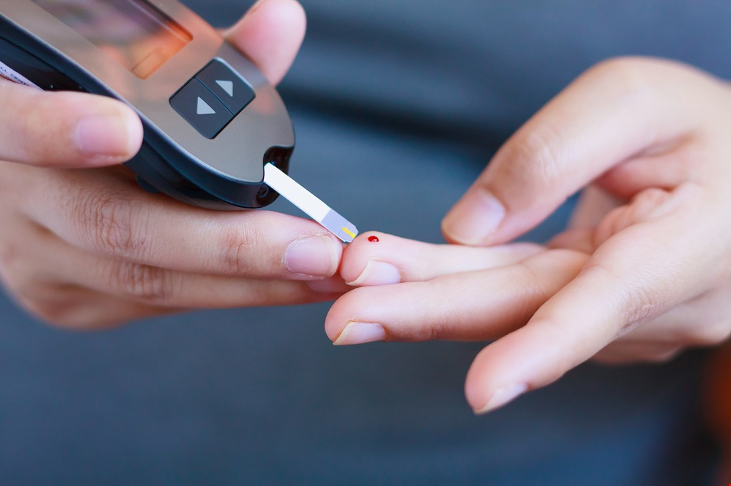
Problem space
Today, people with diabetes need to stick your fingers every day, some of them several times a day to check the level of blood sugar
Foto: diabetesforbudet

Slide 3
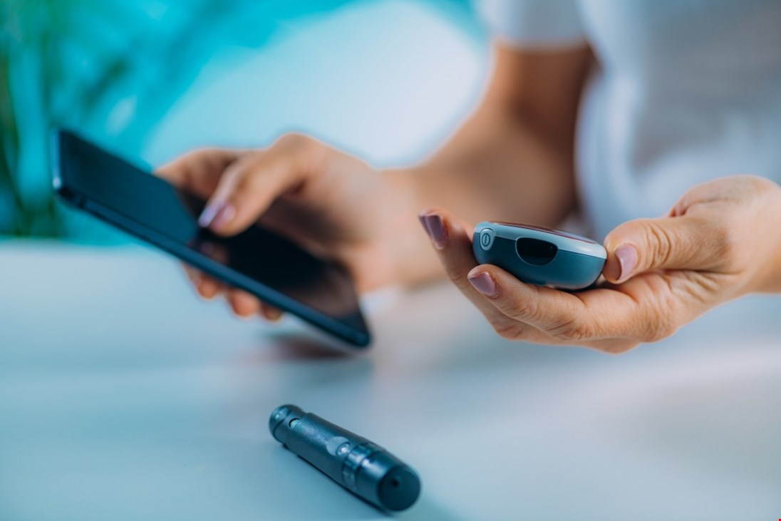
Target group
The target group of our product are people with diabetes
Foto: diabetesforbudet

Slide 4

idea
Our idea is to present an equipment that allows checking the glucose level that is not invasive. That’s means, people will no longer need to stick their finger out.
Foto: internet

Slide 5
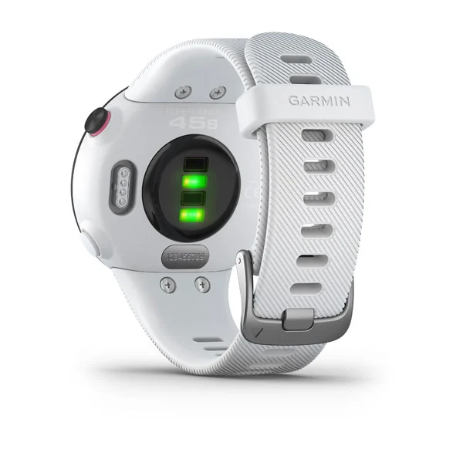
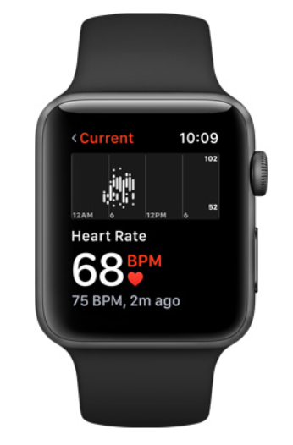
idea
A smart watch that shows glucose level at the time the user wants, discreetly and without constraints.
Foto: Garmin
Foto: Apple

Slide 6
Similar products
BioMKR

Slide 7
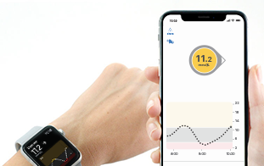
Similar products
Dexcom G6 CGM-systemet
People can find out what your glucose level and take control of your diabetes without the need for fingerprints or calibrations
Foto: dexcom.com

Slide 8
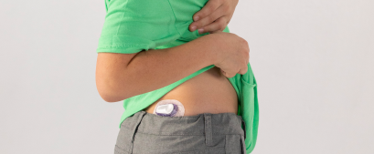
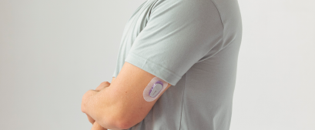
Similar products
Dexcom G6 CGM-systemet – how does it work?
The person must have a sensor under the skin to measures continuously the glucose level and sends data wirelessly to a display device using a transmitter.
Foto: dexcom.com

Slide 9
Similar products
Eversense:

Slide 10
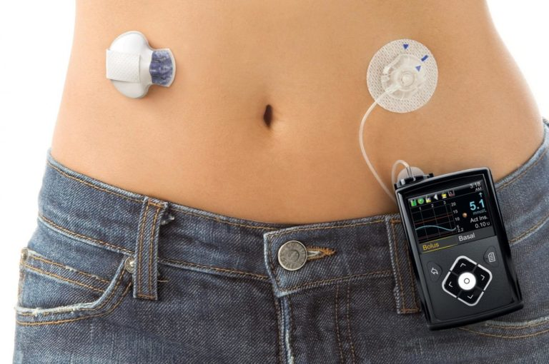
Similar products
Closed loop systems

Slide 11
List of references
Klokke for ikke‐blodig måling av blodsukker
https://www.ntnu.no/documents/10355/1262992082/Prediktor+-+Kybernetisk+fagdag+071114.pdf/182ddd08-8c43-4196-9fab-77ff2ee2be1c?fbclid=IwAR3wBctUh1xR7e8L_9dTwjb1kzYbX8TcK1C5W6c8f9Sto18P59uJwtcEMaE Klokke kan oppdage diabetes og høyt blodtrykk
https://komputer.no/it-og-samfunn/smartklokken-kan-oppdage-diabetes-og-hoyt-blodtrykk smarte diabetesapper
https://levmeddiabetes.no/2014/02/diabetesapper/ Dexcom G6 Continuous Glucose Monitoring (CGM) System
https://www.dexcom.com/nb-NO/no-dexcom-g6-cgm-system Målinger av blodsukker
https://www.diabetes.no/globalassets/helsepersonell/diabetesforum/nasjonalt-diabetesforum-2017/apotekansatte/tilla-landbakk.pdf BioMKR for kontinuerlig ikke invasiv måling av blodsukker hos personer med diabetes.
https://helseforskning.etikkom.no/Content/975678/GlucoPred%202%20studien.pdf Tim Cooks blodsukker gir fart på Apple Watch-rykter
https://e24.no/teknologi/i/kJvJM9/tim-cooks-blodsukker-gir-fart-paa-apple-watch-rykter About Closed Loop System (CLS):
https://loopkit.github.io/loopdocs/
https://medium.com/@loudnate/the-history-of-loop-and-loopkit-59b3caf13805
https://levmeddiabetes.no/2019/06/closed-loop-system-overgi-diabetesen-din-til-teknologi/
https://www.thediabetescouncil.com/closed-loop-systems-future-treatment-for-diabetes/
den perfekte diabetesapp?
https://levmeddiabetes.no/2019/04/kunne-dette-blitt-den-perfekte-diabetesapp/

Slide 12
The end
Thank you for your attention

